Slide 1
Trapezoidal Rule
Group 4

Slide 2
Members
Willy Mwaura – SCT211- 0310/2020 : code
Mary Wambui – SCT211- 0470/2021 : presentation
Sandra Kihoro – SCT211-0308/2020 : Slides

Slide 3
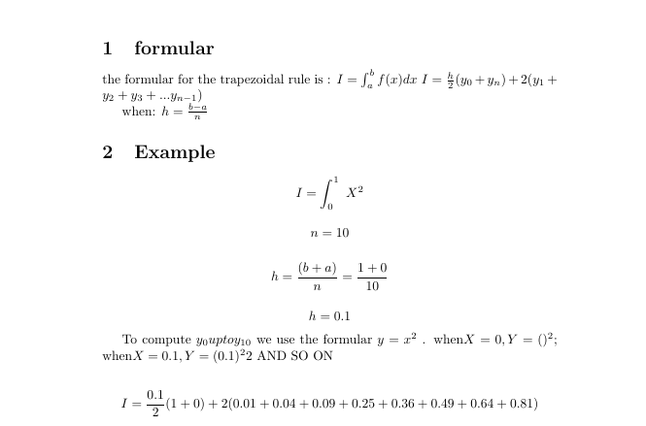
Ans=6.2

Slide 4
Values of y0 up to yn
X | 0 | 0.1 | 0.2 | 0.3 | 0.4 | 0.5 | 0.6 | 0.7 | 0.8 | 0.9 | 1
Y | 0 | 0.01 | 0.04 | 0.09 | 0.16 | 0.25 | 0.36 | 0.49 | 0.64 | 0.81 | 1
 |  |  |  |  |  |  |  |  |  |  | Y 10
 | y0 | y1 | y2 | y3 | y5 | y5 | y6 | y7 | y8 | y9

Slide 5
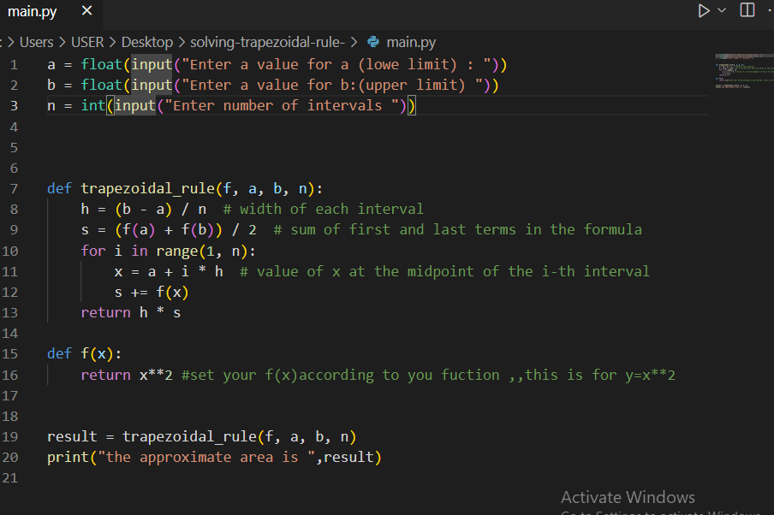
CODE

